Slide 1
Meghnath Reddy Challa
Portfolio of Projects - Data Scientist

Slide 2
Customer Defection – Auto New Business Churn Model
Business Problem - High Churn Rate within first 90 days.
Phase 1 – Work with call representative team to retain the customers who have high probability to churn .
Deliverables
A spreadsheet with list of policies and necessary data for reps to use to make a call.
Looker Studio Dashboard to monitor the progress of the experiment.
Training set - Historical data from 2018-2020 which includes Policy, Driver & Vehicle related features.
Evaluation - An XGBoost Classification Model with AUC of 0.71.
Model deployment - Using Vertex AI, with bi-weekly batch runs.
Results - “Test Group” had a lower churn rate of 3.14% compared to the “Control Group" of 4.61%, saving about ~$500K in lifetime premium.

Slide 3
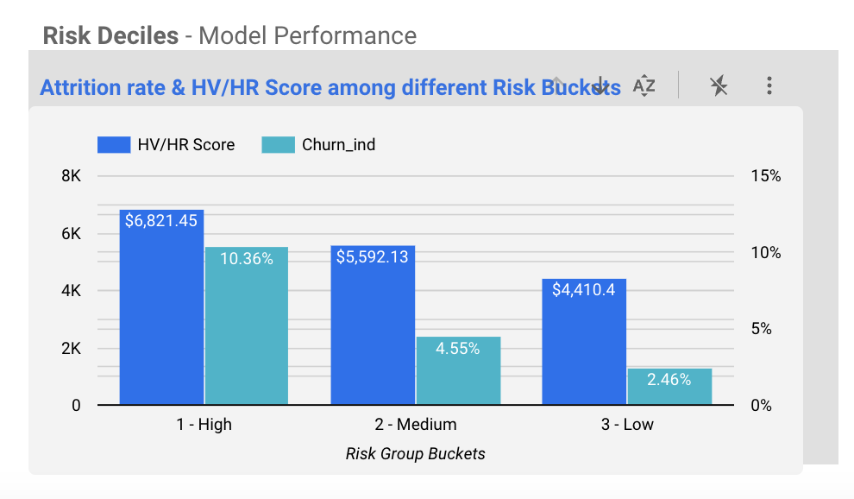
Phase 2 – High Value/High Risk Customers
Problem
How to avoid Unprofitable business ?
Solution - Use Customer LifeTime Value Model
How to reduce operational cost?
Solution – Introduce Email experiment
Results
By targeting, only the top 20% risk group policies, we saved around $250K and cut operational costs by 80% compared to the first phase.
Model Performance
Notes:
HV/HR Score = ((100-Probability of Customer to Stay)*30 years Net Present Value)/100
Challenges – Understanding the life cycle of Policy, Different data sources, Looker Studio, Working with Advocacy team for setting standards in tracking the outcome

Slide 4
KPI Forecasting – Quotes, Sales, Responses, WP
Business Problem – Workforce and Marketing team needed daily level forecasts to allocate resources more effectively compared to previously used monthly forecasts.
Deliverables
A spreadsheet with yearly forecast at a daily level.
Collaborate with the Build team in order to develop a Power BI dashboard that allows the business to monitor and compare the Planned and Actual forecast data.
Training set - Historical data ranging from 2019 to 2021, which includes actual KPIs, lag values as well as other independent features such as "day_of_week," "month," "is_public_holiday" etc., to aid identifying patterns and trends over time.
Evaluation – Models such as XGBoost Regressor, Facebook Prophet, and LSTM Model are used. However, the LSTM Model outperformed the others in relation to MAPE.
Final Adjusted Model Forecasts – To match with the monthly planned values.
Results – The overall trend and seasonality were accurately captured, although unusual instances of historical spikes were also factored into the forecasting process. For instance, if there was a spike in numbers on Jan 15, 2021, as a result of a special campaign, the model might incorrectly predict a similar trend for the following year.
Next Release – Started incorporating campaign data to track and analyze spikes more effectively, resulting in improved forecasting.
Notes:
Challenges - To gain a comprehensive understanding of the business, it was crucial to account for each use case, given that different sources of business have unique operational characteristics. For instance, call center intake channels experience little to no volume on weekends, while the internet experiences a surge in volume over the weekend. Similarly, WP earned is highest at the start and mid-point of the month, as the majority of payments are made during this period.

Slide 5
Other Projects
Business Problem
How to identify & prioritize Home policies that are subject to external inspection and are at high risk of non-renewal?
Solution : Used SHAP values and identified features like “Age of Home”, “exposed wiring”, “roof rotting”, “siding missing”, “roof type” had a significant impact on non-renewal. Based on these results, recommendations were provided to the underwriting team to assist them in prioritizing the list of policies that required immediate attention.
Analyzed the frequency and severity of claims within different QI (Quality Improvement) score groups.
Part of team that was responsible for creation of dataset for Acxiom Daily Refresh to support BI Team.
Built a dashboard to display the customer base according to census tracts.
Below are some In-flight Projects
How can we determine whether the potential losses for a given policy in its upcoming term will exceed the pre-defined threshold limit?
Solution : Built a Loss Ratio model by using policy term level & claims information. However, model still requires refinement and tuning to enhance the evaluation metrics.
Part of team which focuses on modifying queries that were originally designed for on-premises systems so that they could now reference the point-in-time tables in GCP.
Think from the perspective of an Underwriter and identify potential factors that may result in an auto policy being flagged for non-renewal. Develop a machine learning model to predict non-renewal.

